Slide 1

Virtual Idol Management Database
Team 2
Rina Su - 002308528
Krisha Lakhani - 002334794
Adwait Relekar - 002839566
Reetika Bhanushali - 002341895
Prayag Adhikari - 002657754

Slide 2
01
INTRODUCTION

Slide 3
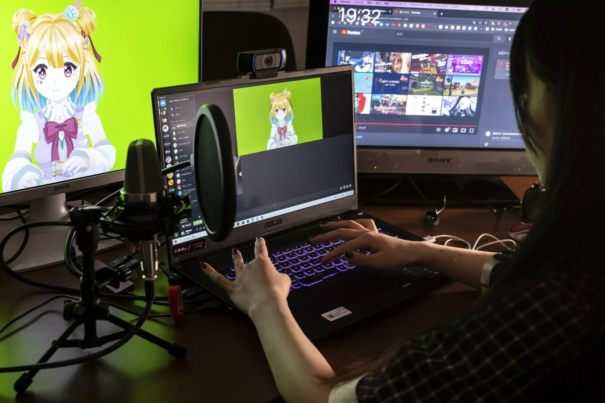
Introducing Virtual YouTubers: The Rise of Digital Personalities
What is a Virtual YouTuber (VTuber)?
Definition of VTuber:
-A VTuber is an online content creator
-Uses a computer-generated avatar instead of showing their real face.
Data Management:
VTuber profiles Key features:
Content (live streams, videos, and channels)
Audience interactions and engagement metrics
Business activities (sponsorships, merchandise, and partnerships)
Project Purpose:
Our database is designed to manage information, content, audience interactions, and business data for VTubers. It aims to provide a unified platform that simplifies:
Tracking of VTuber information and activities
Management of video content and live streams
Analysis of social media interactions and viewer engagement
Monitoring of revenue streams and partnerships
Optimization of content strategies to support growth
Digital Persona:
The avatars are often inspired by anime-style characters.
Technology Used: Motion Capture and Virtual Tools

Slide 4
02
BUSINESS RULES

Slide 5




Business Rules
Virtual Idol Relationships:
Each Virtual Idol:
Has exactly one YouTube channel.
Can perform only one live stream at a time.
Can utilize one or many platforms for content distribution.
Can use zero or multiple vocal changers.
Audience Engagement:
Each viewer:
Can follow multiple YouTube channels.
May write zero or many reviews for content.
Can participate in zero or multiple donations to support idols.
Collaborations:
Each Virtual Idol works with:
One painter for image creation.
One motion capture specialist for animation and movement.
Live Stream Content:
Each live stream:
Can discuss one or many topics.

Slide 6
03
Entity Relationship Diagram

Slide 7
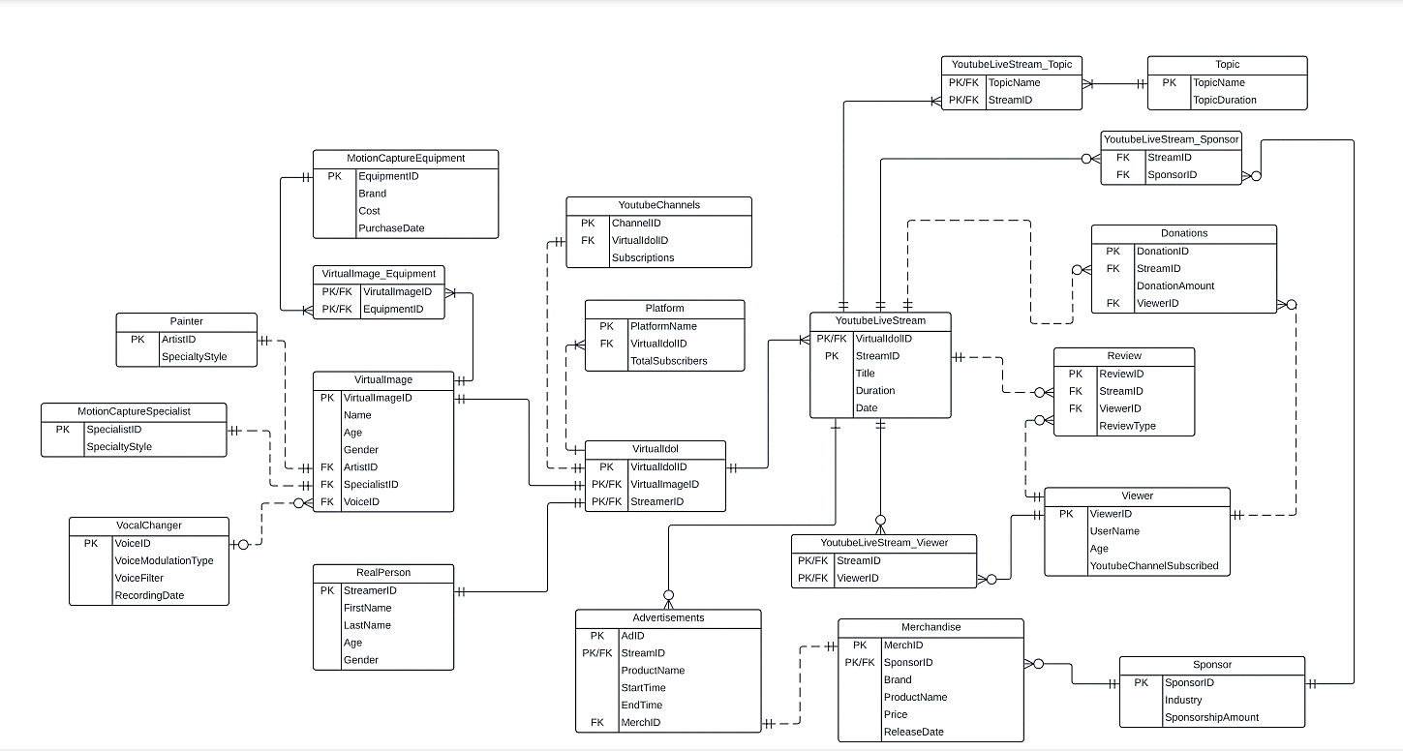
Entity Relationship Diagram(ERD)

Slide 8
04
DATABASE IMPLEMENTATION

Slide 9
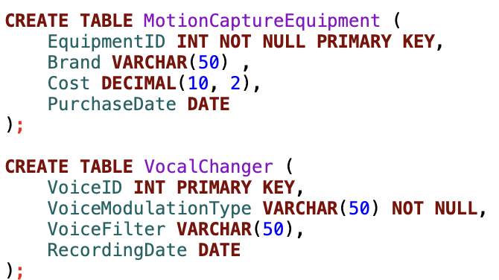
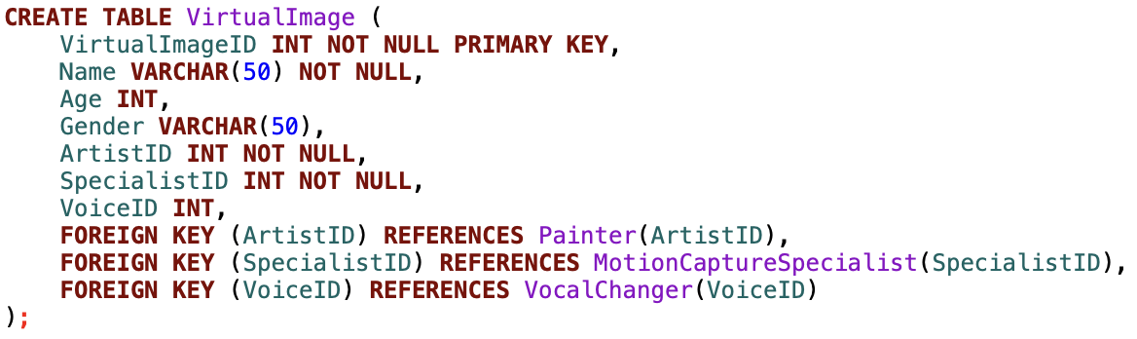
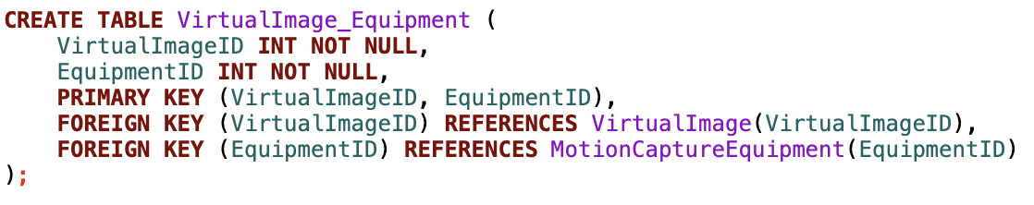
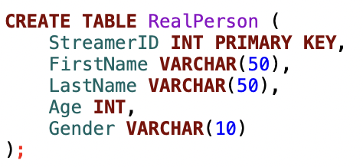
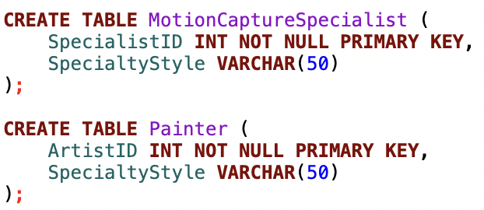
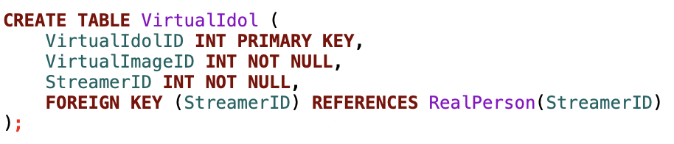
Table Creation

Slide 10
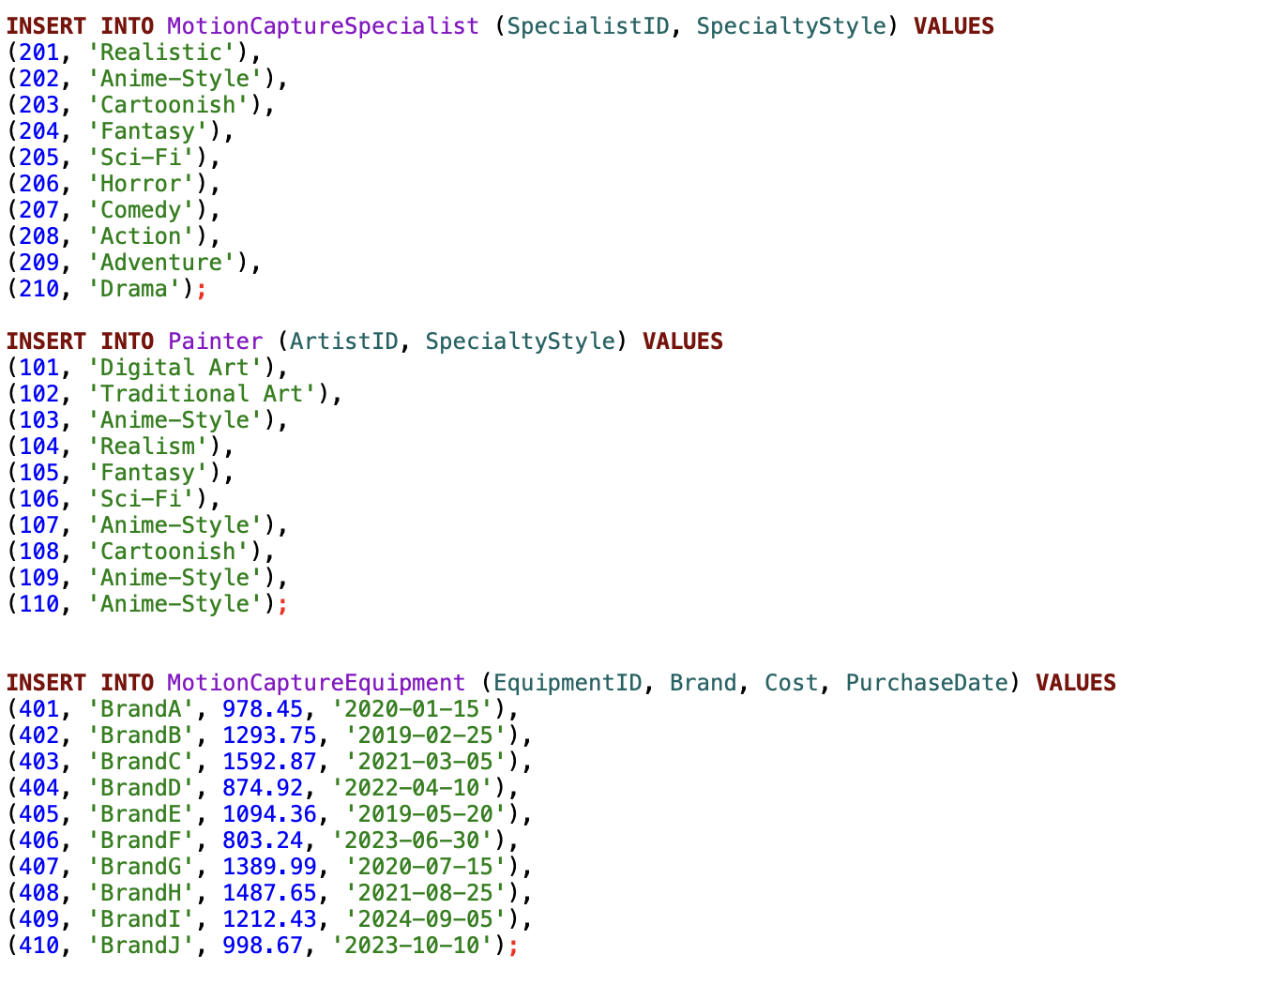
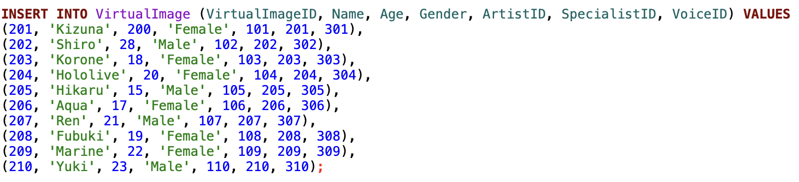
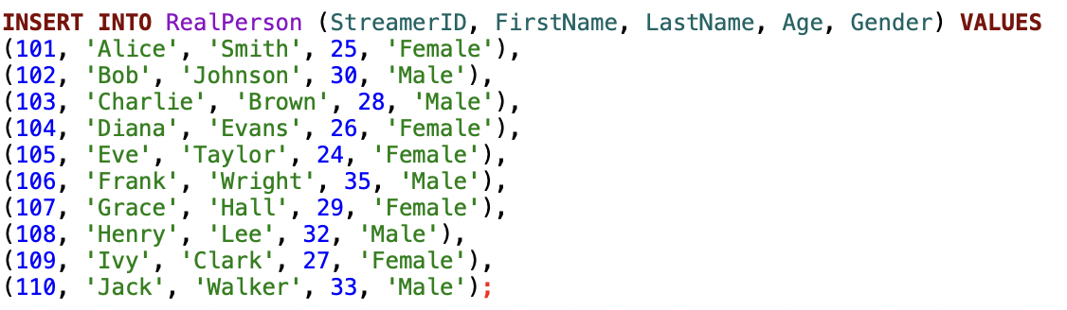
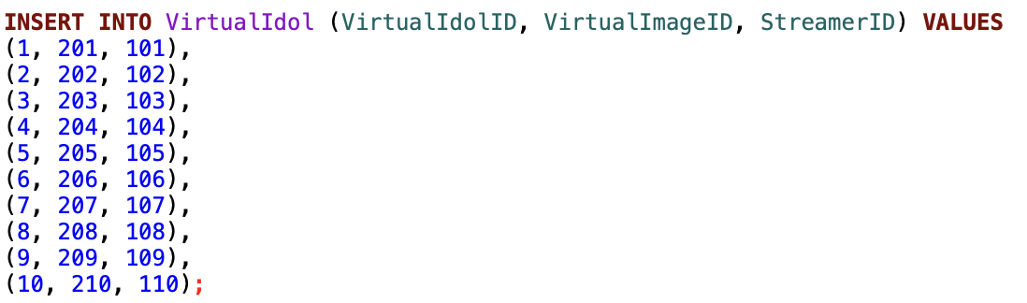
Data Insertion

Slide 11
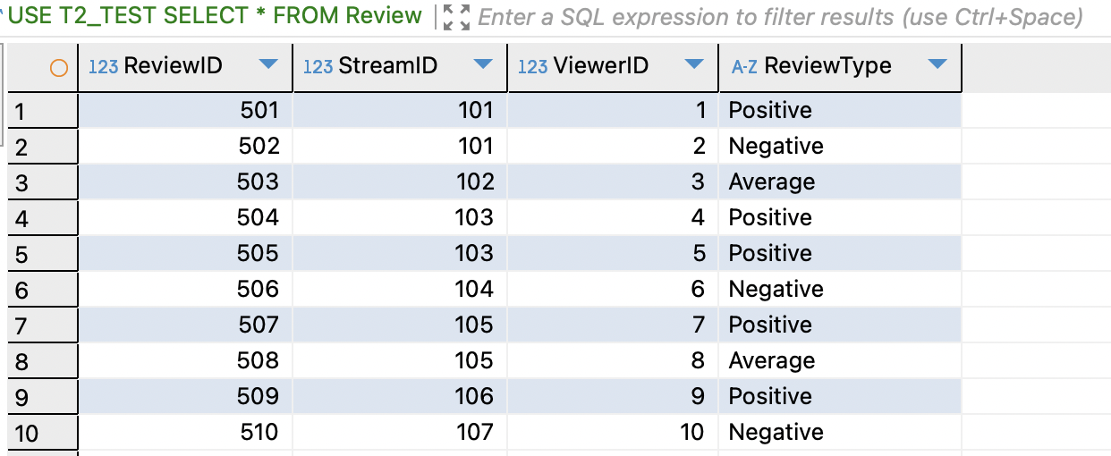
Check Constraint

Slide 12
05
VIEW, REPORT & ENCRYPTION

Slide 13
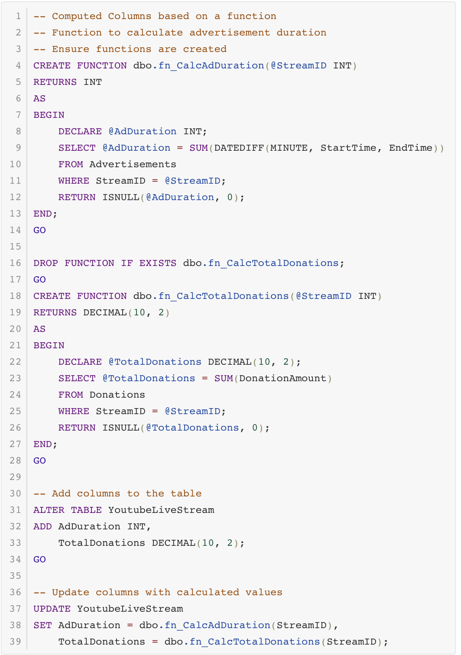
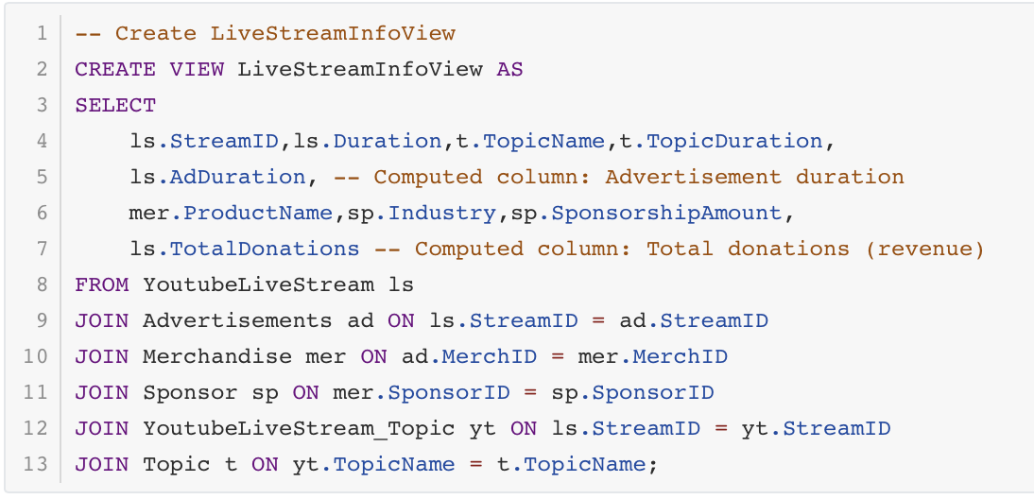
Live Stream Info View

Slide 14
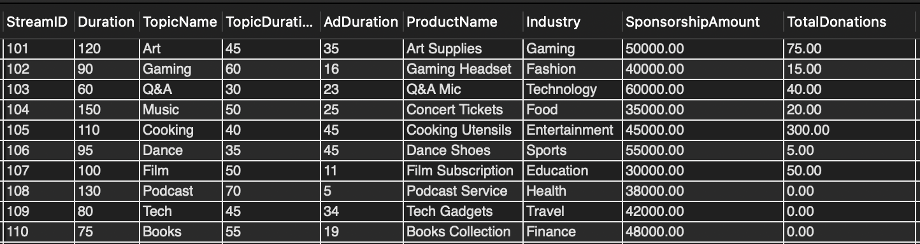
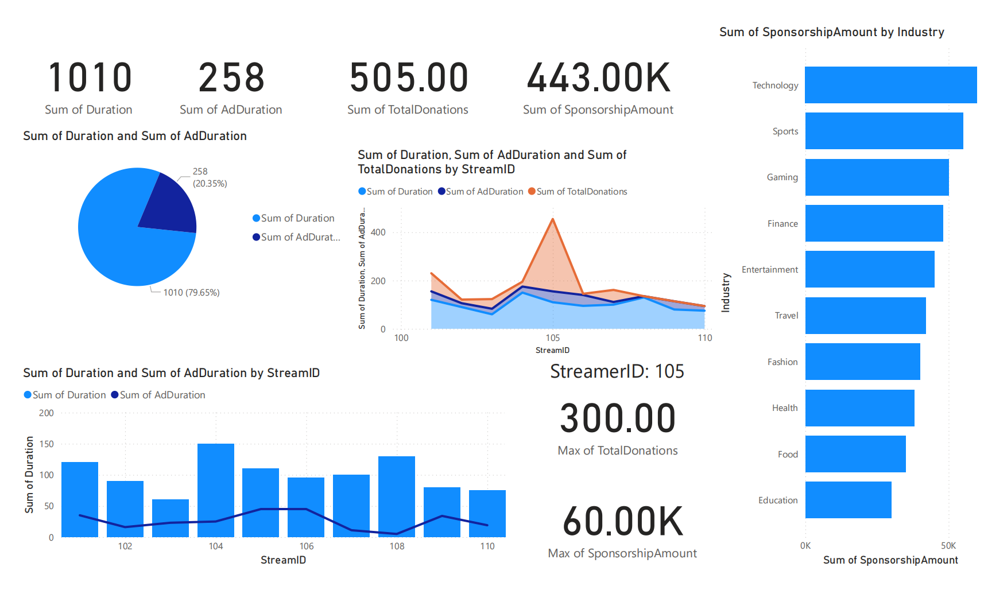
Live Stream Info View

Slide 15
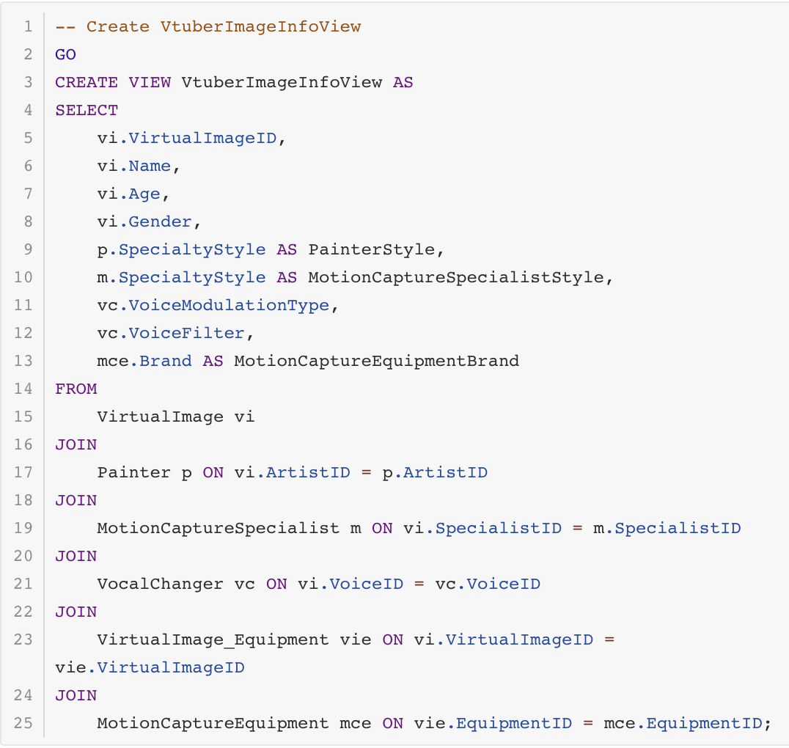
Vtuber Image Info View

Slide 16
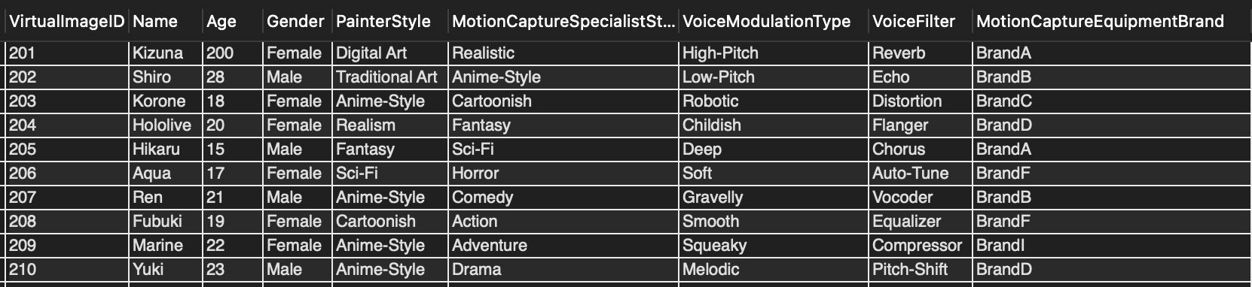
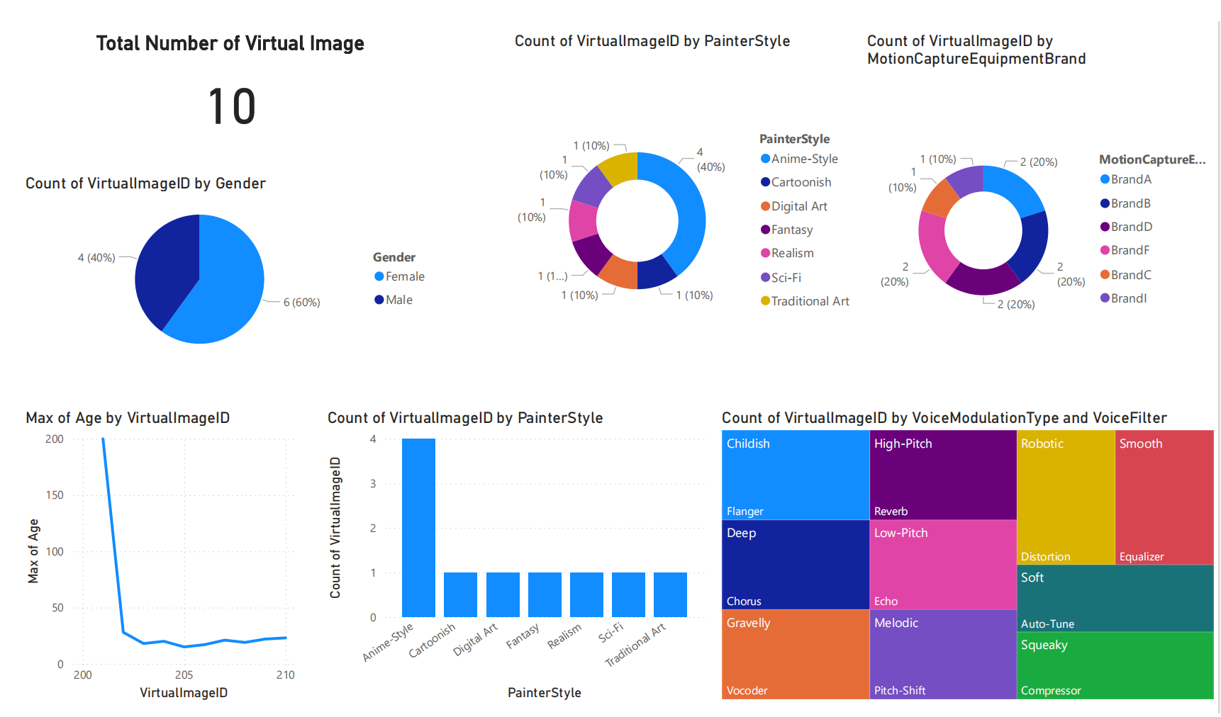
Vtuber Image Info View

Slide 17
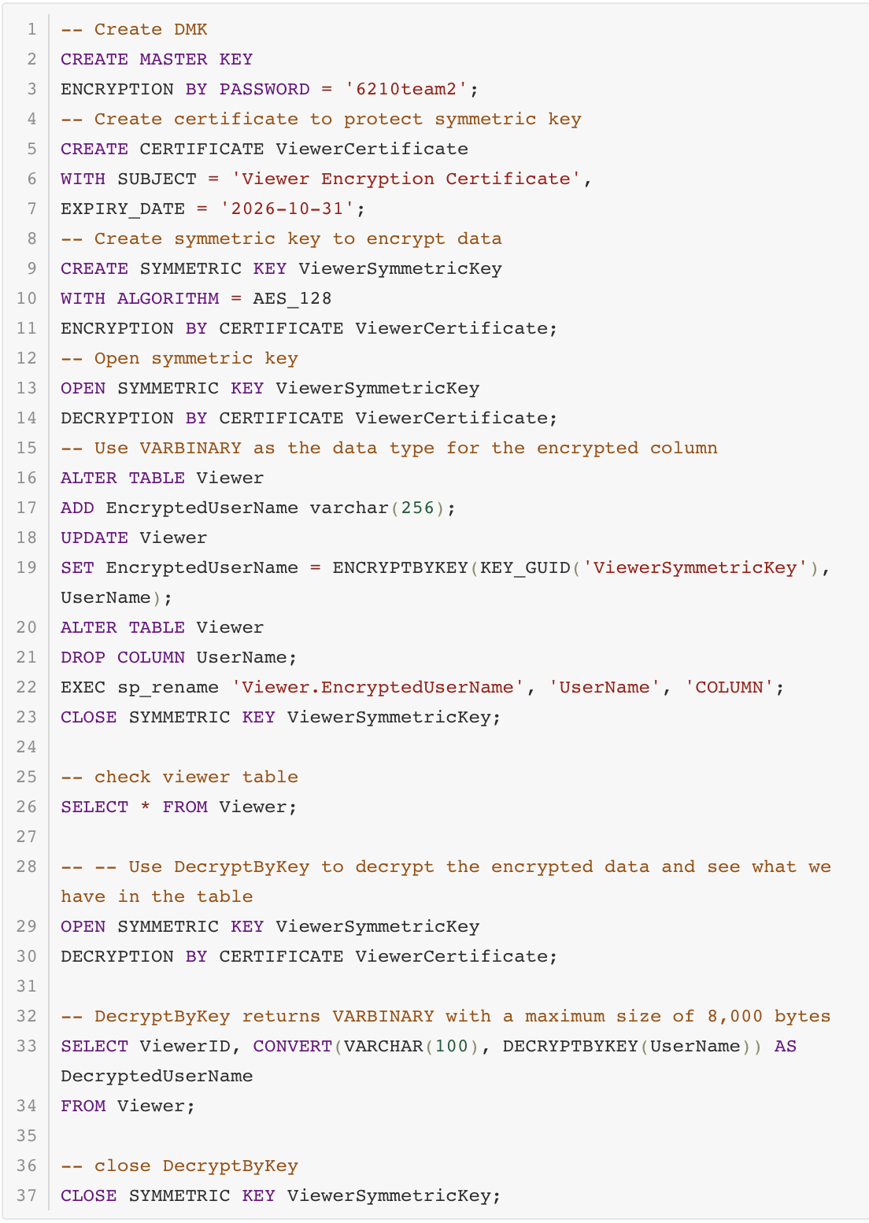
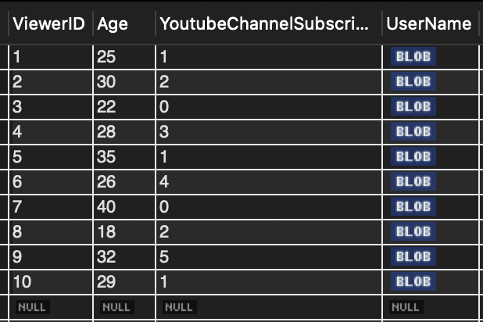
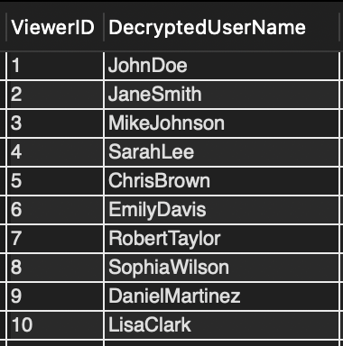
Database Encryption

Slide 18

Q & A

